Slide 1

Missing the Bus: A real-time analysis of bus cancellations and early arrivals on SEPTA’s bus network
Mid-point presentation
Will Friedrichs

Slide 2


Motivation
Why cancellations and early buses specifically?
Personal experience – missing the bus
Prevalent Google Maps use, finding the “Cancelation Gap”
Lack of accessible cumulative data on these issues
SEPTA
TransitView
GTFS
real-time

Slide 3
Defining Question
In tracking SEPTA bus early arrivals and real-time cancellations across routes, stops, and times over the course of a month, which routes and stops are the most adversely affected?
Are there patterns across days or weeks?
Do the areas most affected by these problems correspond with the most disadvantaged communities?
Do they correspond with routes having the lowest ridership?

Slide 4
Existing Research
The nature of cancellations and delays in bus networks
Early departures especially bad during infrequent service
Detrimental to bus transfers, which SEPTA has been encouraging
GTFS: Inconsistent use, even today
California study: 54% with GTFS feeds; 19% with GTFS-rt feeds
SEPTA GTFS: Bus cancellation gap

Slide 5
Technical implementation
Python scraper running indefinitely on server
Amazon EC2, can connect to any laptop remotely
Two programs run concurrently
One writing SEPTA updates
One converting those SEPTA updates to Usable CSVs
SEPTA Stream
Program 2
Program 1
Internal arrays
TXT update
CSVs

Slide 6
Technical implementation: Program 1
Part 1: writing updates to server
Checks for updates to the timestamp of the most recent SEPTA, every 2 seconds
If there is a new timestamp, write to server a new update (block of data which contains several of the chunks displayed to the right)
There may be a backup, this is okay
"lat":"40.022942",
"lng":"-75.078666999999996",
"label":"7445",
"VehicleID":"7445",
"BlockID":"1055",“
Direction":"SouthBound",
"destination":"Frankford Transportation Center",
"Offset":"1",
"heading":180,
"late":0,
"original_late":-3,
"Offset_sec":"21",
"trip":"670961",
"next_stop_id":null,
"next_stop_name":null,
"next_stop_sequence":null,
"estimated_seat_availability":"NOT_AVAILABLE",
"timestamp":1644579125}, =

Slide 7
Technical implementation: Program 2
Part 2: Making data into CSVs
Checks for new .txt files, and permissions allowing, writes to the internal database then deletes
There may be a backup, if so: read the oldest one
Every ten minutes, write to CSVs
This is when the backup of files created by Part 1 will start to add up
10 minutes gives Part 2 enough time to work through the files of Part 1

Slide 8

Implementation Issues
Time-dependent nature of data-collection
Having to run Part 1 to get more updates
Threading troubles
Overnight bus route issues
Amazon EC2 performance issues

Slide 9
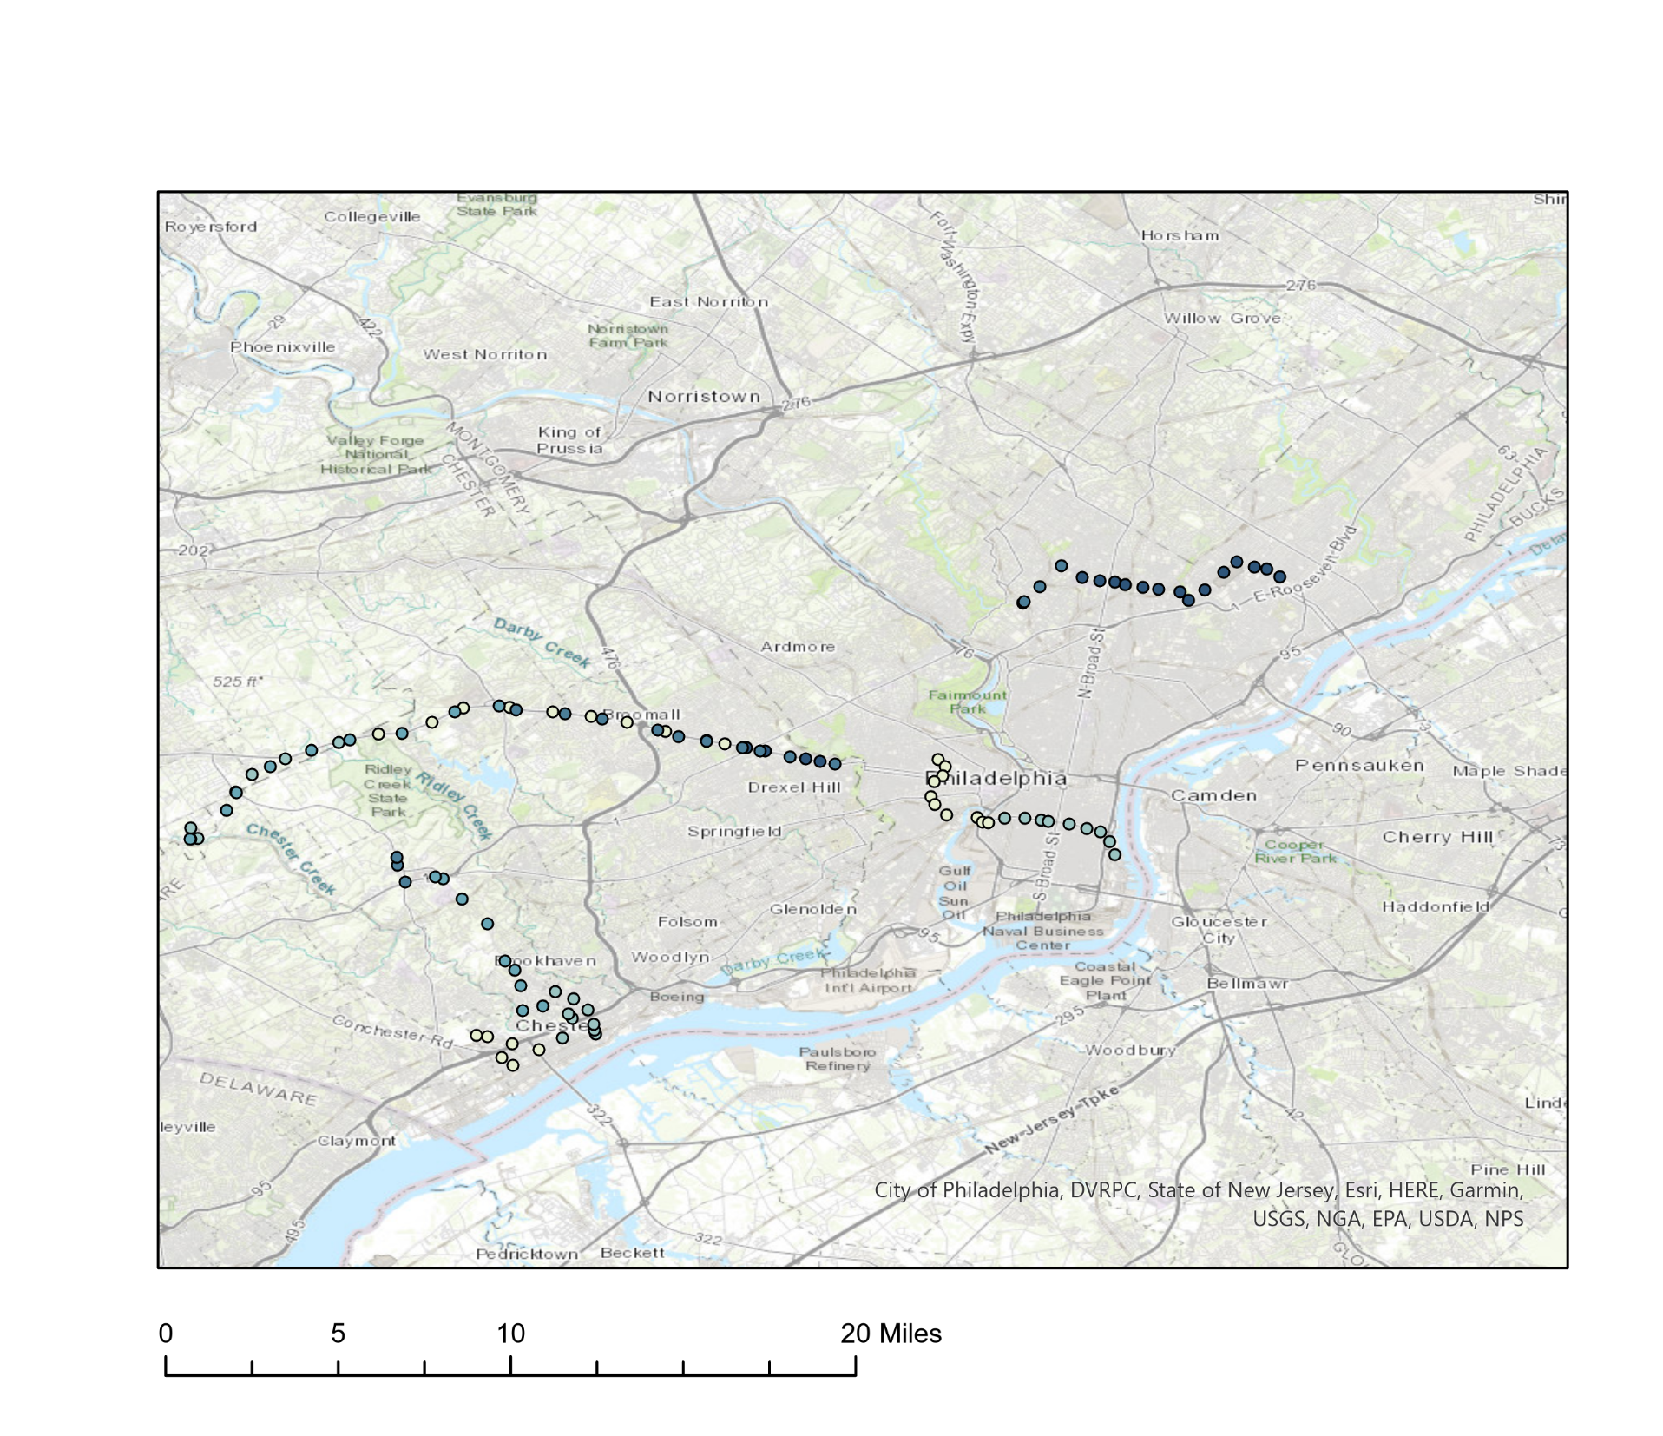

Previous Tests: Example 1
Cancellation Time
8:38 PM
9:38 PM
10:38 PM

Slide 10
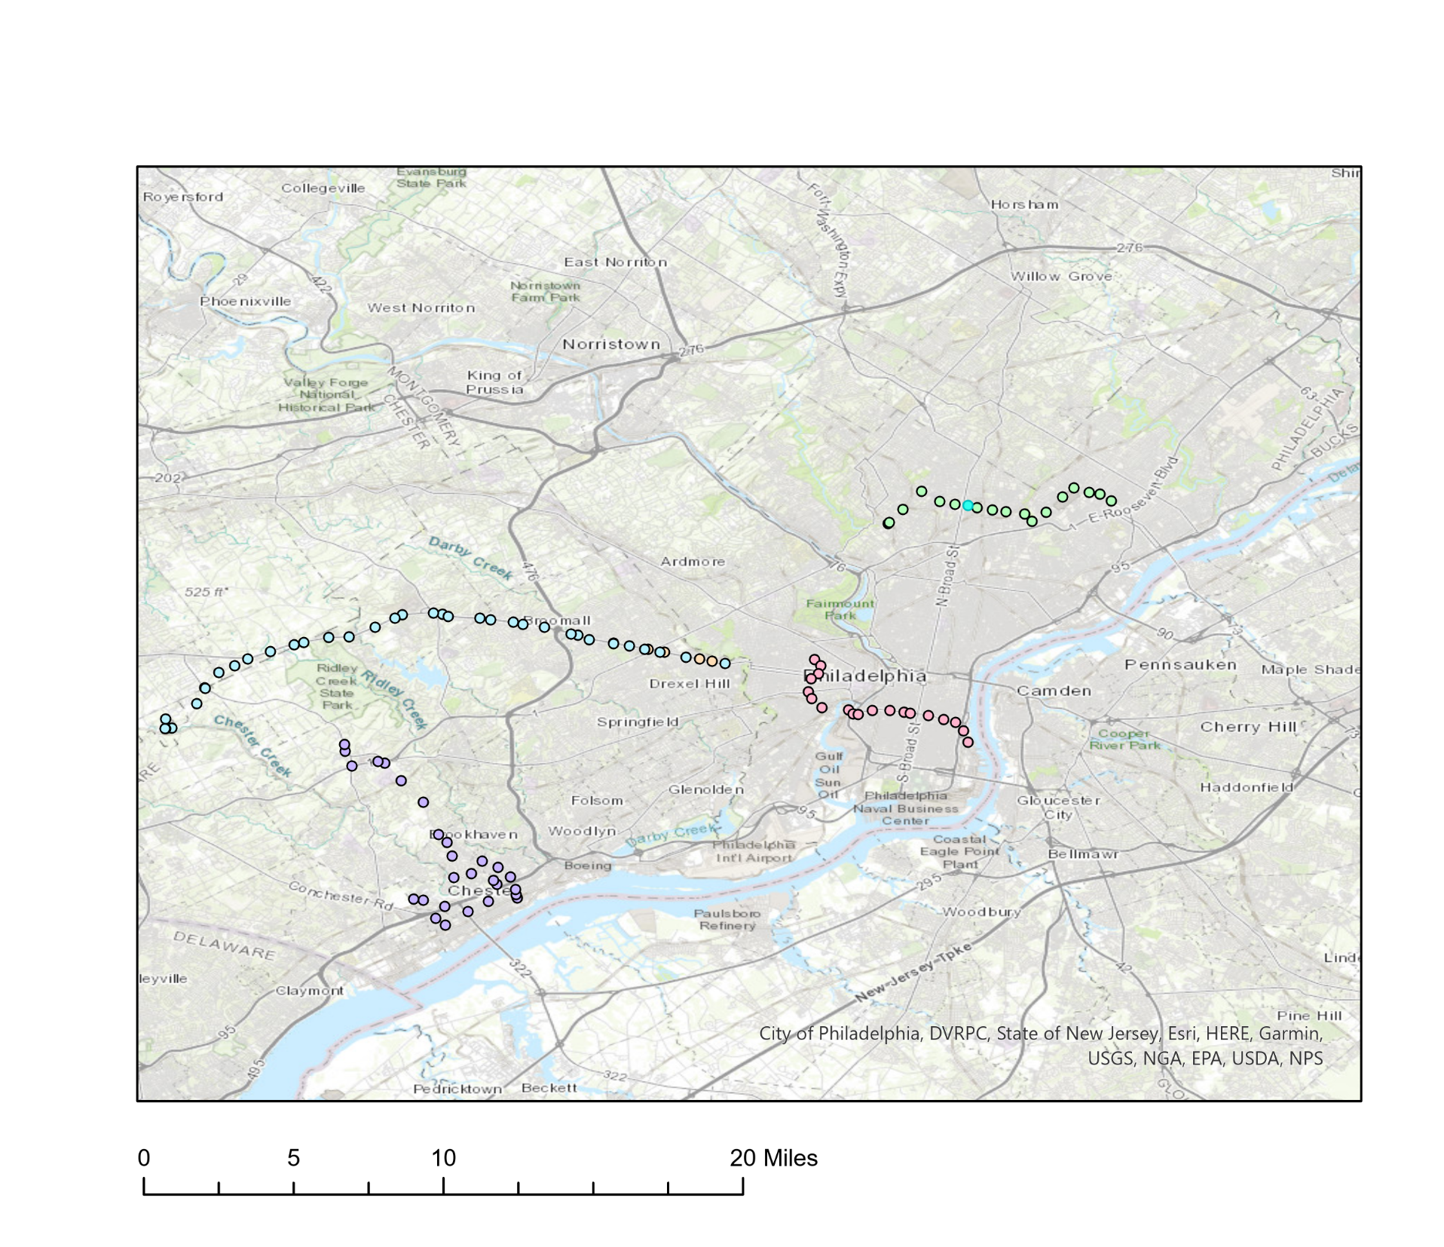
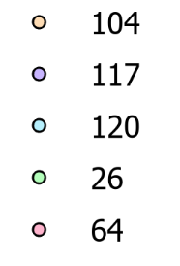
Previous Tests: Example 2
Bus Route

Slide 11
Data Analysis
Analyzing the regularity of cancellations and buses 5+ minutes early
Stop by stop rather than trip by trip
Lateness varies across a trip
Sometimes a trip is cancelled partway through
Instances of late and cancelled buses versus number of trips
Highlighting low frequency routes
Patterns across time of day, etc.
Ridership data, car ownership, income, demographic info

Slide 12

Thank you!
Questions?

